Slide 1
神经网络的相图分析
许志钦
2023年11月10日

Slide 2
Motivation
T Luo#, ZQJ Xu#, Z Ma, Y Zhang*, Phase diagram for two-layer ReLU neural networks at infinite-width limit, JMLR, 2020

Slide 3
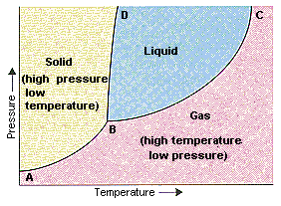
Phase diagram
Phase diagram for matter
distinctive states of matter <-> environment
(phase transition happens at infinite size limit)
solid, liquid, gas <-> pressure, temperature
Phase diagram for two-layer ReLU NN
distinctive training dynamics <-> initialization
($m→∞$)
? <->?
T Luo#, ZQJ Xu#, Z Ma, Y Zhang*, Phase diagram for two-layer ReLU neural networks at infinite-width limit, JMLR, 2020

Slide 4
Picture of deep learning with implicit bias
Initialization
loss initialization dynamics
Low frequency interpolations
Linear regime
Non-Linear regime
Nearest
solution
Condensation
Global minima
Parameter space
T Luo#, ZQJ Xu#, Z Ma, Y Zhang*, Phase diagram for two-layer ReLU neural networks at infinite-width limit, JMLR, 2020

Slide 5
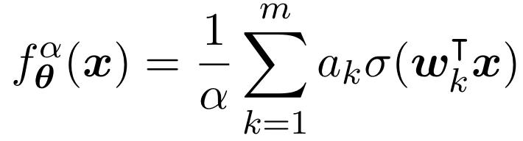
The key factors for regimes
non-linear activation function
Only $w_{k}$ affects the non-linearity
[6] Luo#, Xu#, Ma, Zhang*, 2007.07497, JMLR

Slide 6
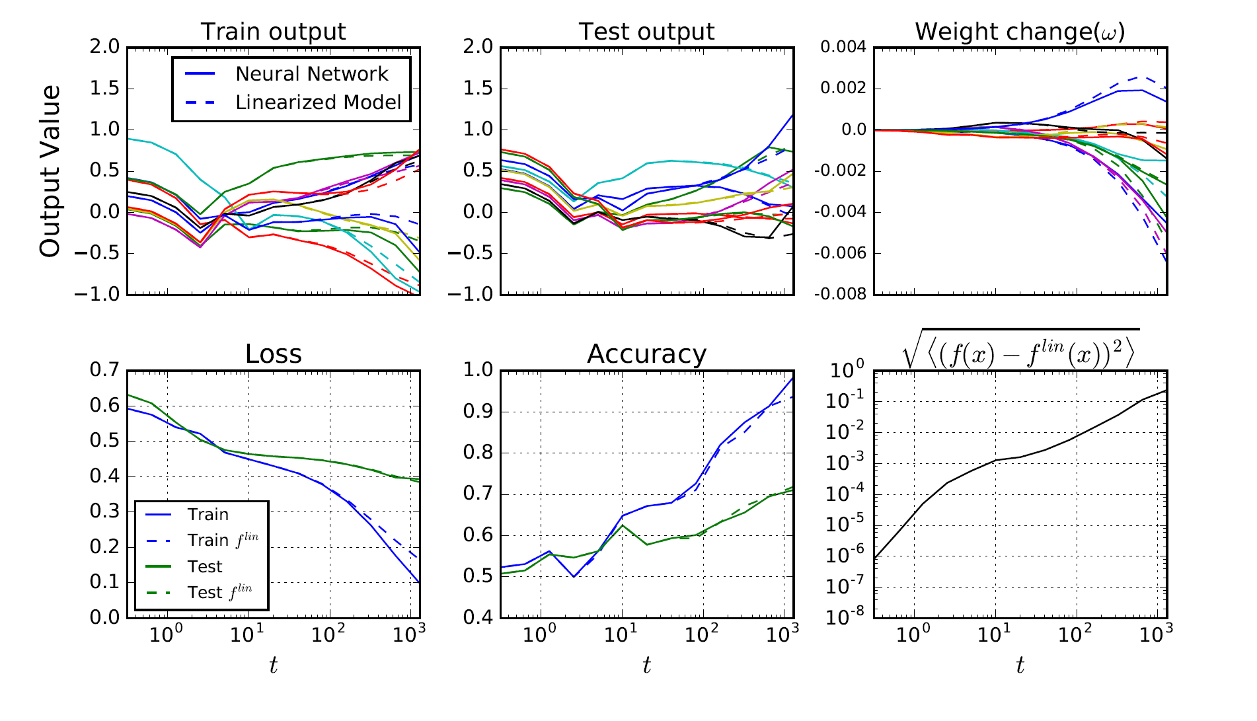
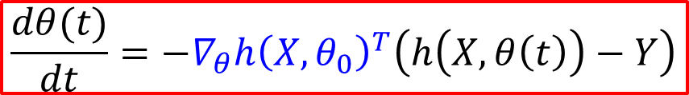
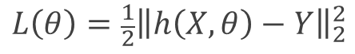
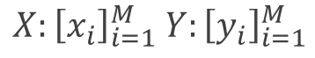
Linear approximation for wide NN
$h\left(x, θ(t)\right)=h\left(x,θ_{0}\right)+∇_{θ}h(x,θ_{0})\left(θ\left(t\right)−θ_{0}\right)$ for any $t>0$
$$\frac{dθ(t)}{dt}=−∇_{θ}h{\left(X,θ_{0}\right)}^{T}\left(h\left(X,θ\left(t\right)\right)−Y\right)$$
$$L\left(θ\right)={\frac{1}{2}\left\|h\left(X,θ\right)−Y\right\|}_{2}^{2}$$
$$X:{\left[x_{i}\right]}_{i=1}^{M} Y:{\left[y_{i}\right]}_{i=1}^{M}$$
CIFAR 10, CNN
Lee et al., 2019

Slide 7
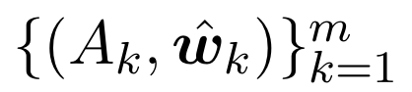
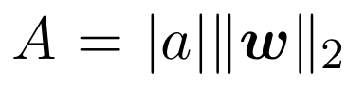
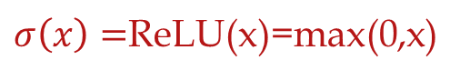
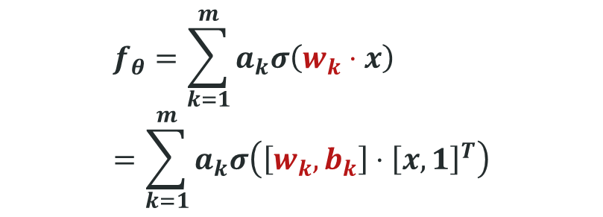
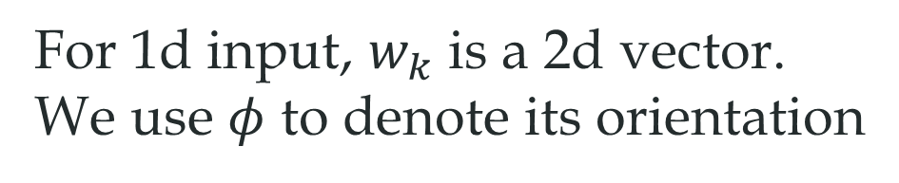
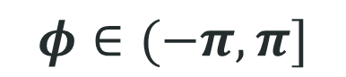
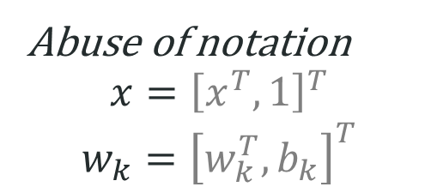
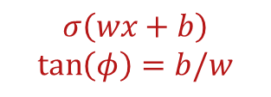
2-layer ReLU neural network
$$f_{θ}=\sum_{k=1}^{m}{a_{k}σ\left(w_{k}⋅x\right)}=\sum_{k=1}^{m}{a_{k}σ\left(\left[w_{k},b_{k}\right]⋅{\left[x,1\right]}^{T}\right)}$$
For 1d input, $w_{k}$ is a 2d vector.
We use $φ$ to denote its orientation
$σ\left(x\right)=$ReLU(x)=max(0,x)
Abuse of notation
$$x={\left[x^{T},1\right]}^{T}$$
$$w_{k}={\left[w_{k}^{T},b_{k}\right]}^{T}$$
$$σ\left(wx+b\right)$$
$$\tan\left(φ\right)=b/w$$
$$φ∈(−π,π]$$
Angle---Turning point
Tao Luo#, Zhi-Qin John Xu #, Zheng Ma, Yaoyu Zhang*,
Phase diagram for two-layer ReLU neural networks at infinite-width limit, Journal of Machine Learning Research (2021)

Slide 8
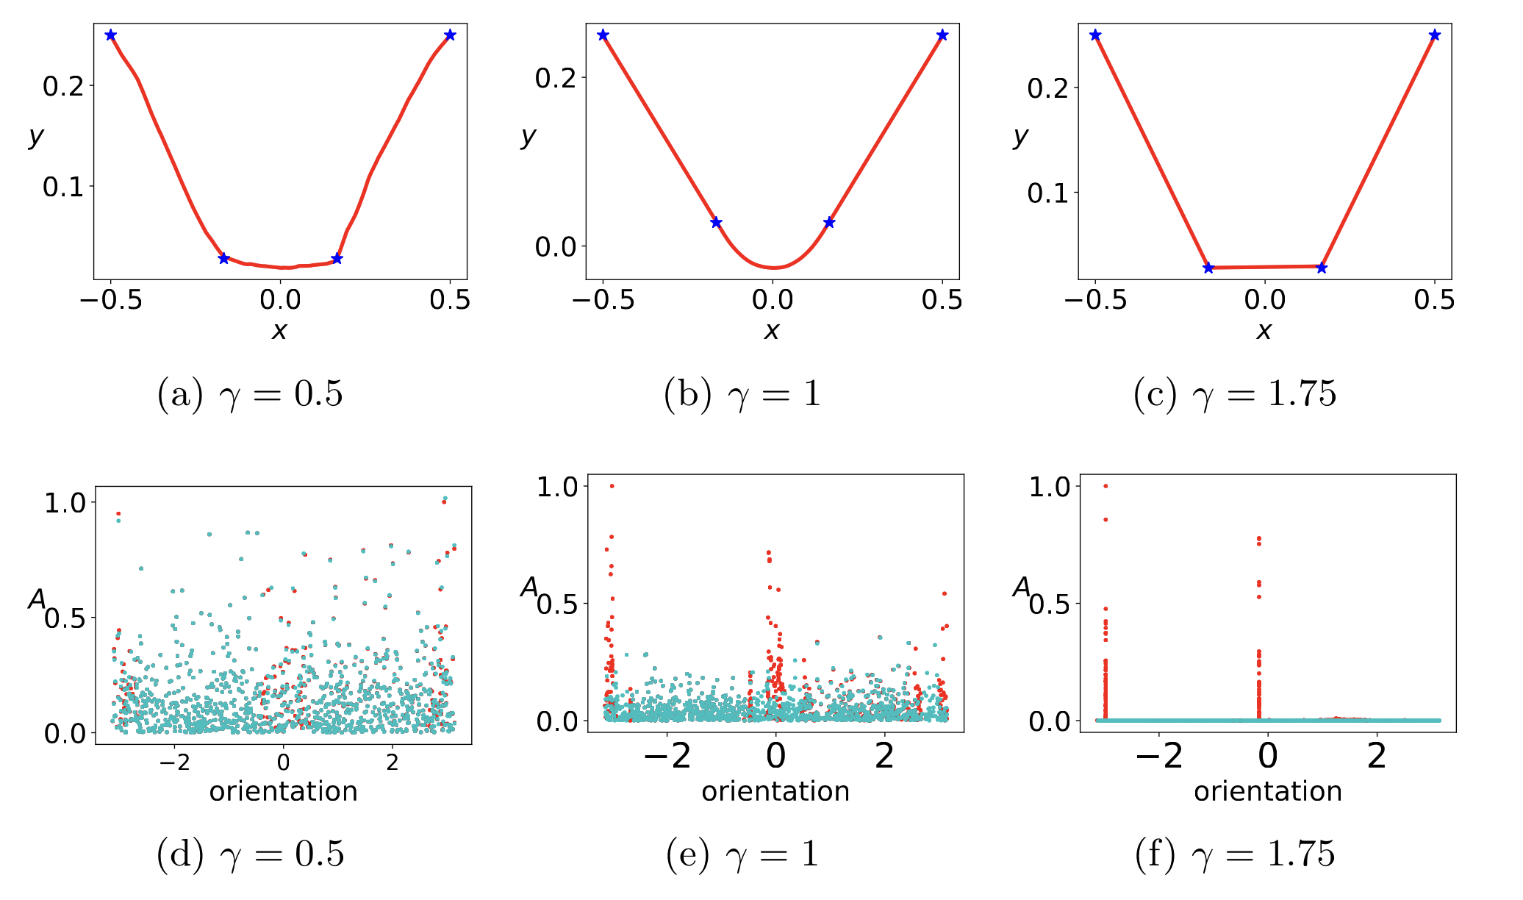
Typical cases across the phase diagram
Linear regime
critical regime
condensed regime
$$γ^{′}=0$$
T Luo#, ZQJ Xu#, Z Ma, Y Zhang*, Phase diagram for two-layer ReLU neural networks at infinite-width limit, JMLR, 2020

Slide 9
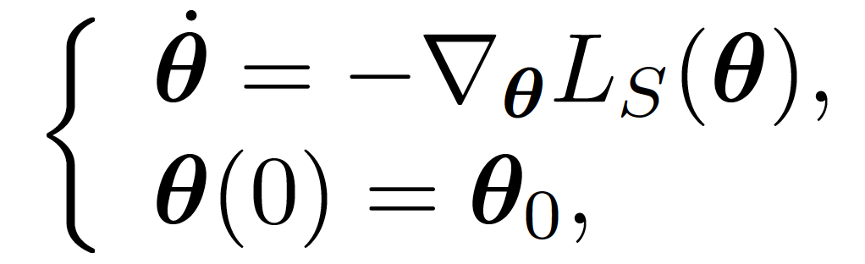
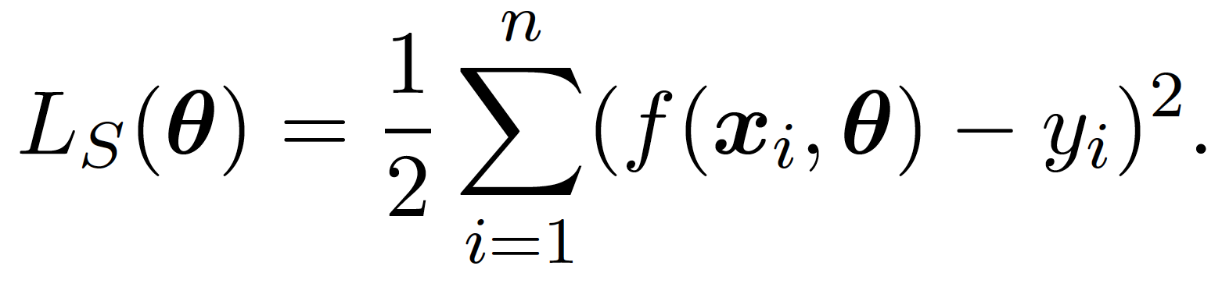
T Luo#, ZQJ Xu#, Z Ma, Y Zhang*, Phase diagram for two-layer ReLU neural networks at infinite-width limit, JMLR, 2020

Slide 10
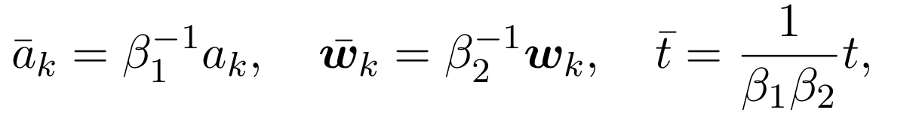
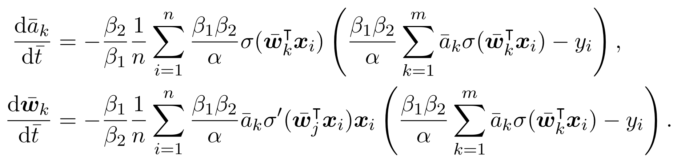
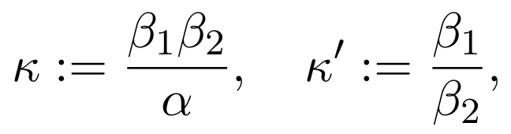
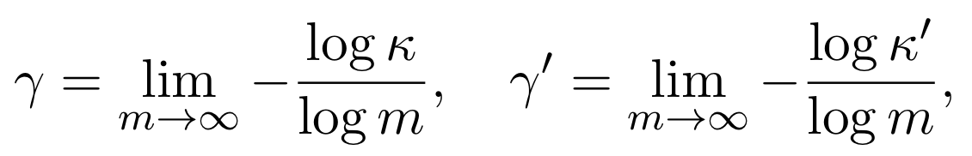
Setup
Two layer ReLU network at infinite-width limit
Normalized gradient flow
Scaling parameters and infinite-width limit
$$x={\left[x^{T},1\right]}^{T}$$
$$w_{k}={\left[w_{k}^{T},b_{k}\right]}^{T}$$
T Luo#, ZQJ Xu#, Z Ma, Y Zhang*, Phase diagram for two-layer ReLU neural networks at infinite-width limit, JMLR, 2020

Slide 11
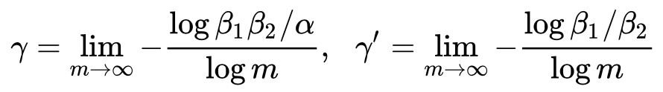
Phase diagram
Phase diagram for matter
distinctive states of matter <-> environment
(phase transition happens at infinite size limit)
solid, liquid, gas <-> pressure, temperature
Phase diagram for two-layer ReLU NN
distinctive training dynamics <-> initialization
($m→∞$)
? <->?
Identification of coordinates of phase diagram (in analogy to pressure, temperature)
Effectively independent
Dynamical similarity
Differentiation capability
T Luo#, ZQJ Xu#, Z Ma, Y Zhang*, Phase diagram for two-layer ReLU neural networks at infinite-width limit, JMLR, 2020

Slide 12
Initialization methods with their scaling parameters
T Luo#, ZQJ Xu#, Z Ma, Y Zhang*, Phase diagram for two-layer ReLU neural networks at infinite-width limit, JMLR, 2020

Slide 13
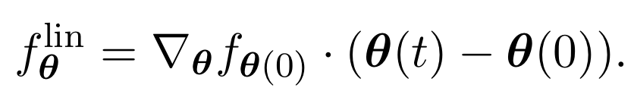
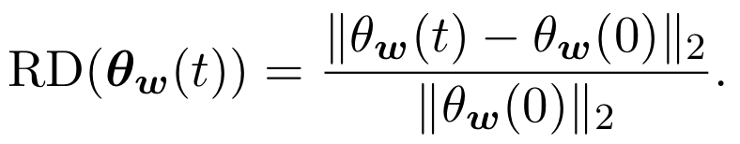
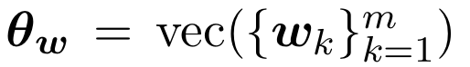
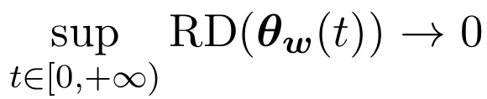
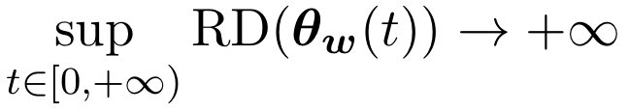
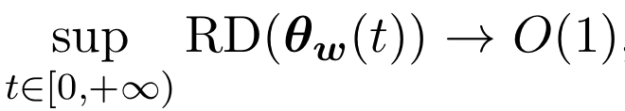
Regime identification
Linear regime (with ASI)
Relative distance
As $m→∞$,
Linear regime:
Condensed regime:
Critical regime:
T Luo#, ZQJ Xu#, Z Ma, Y Zhang*, Phase diagram for two-layer ReLU neural networks at infinite-width limit, JMLR, 2020

Slide 14
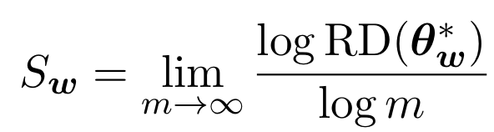
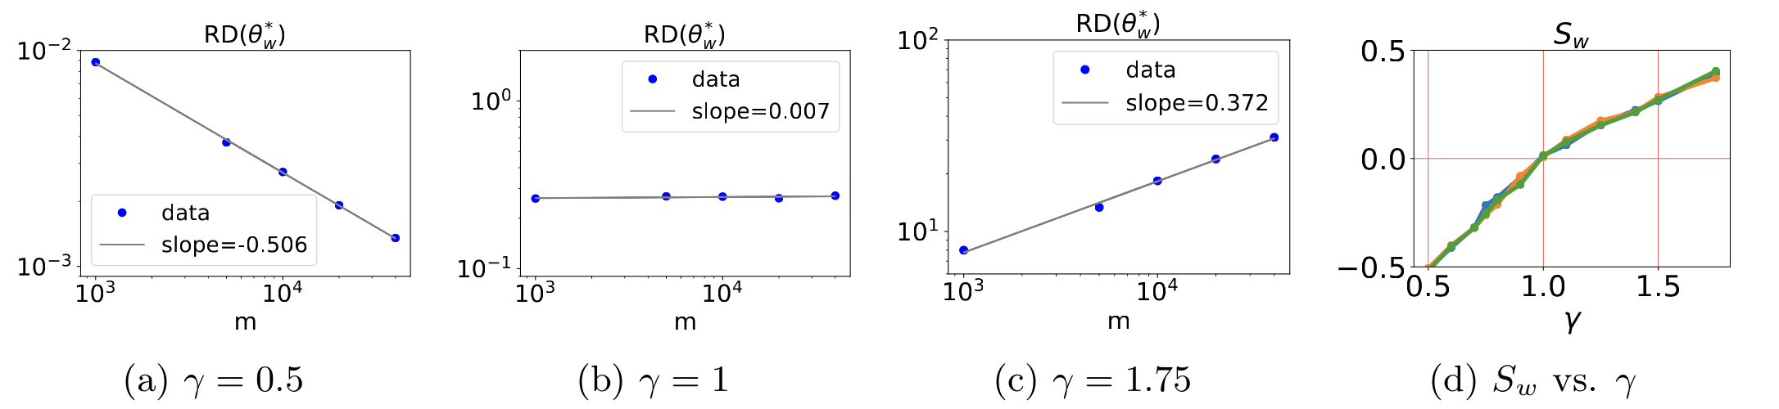
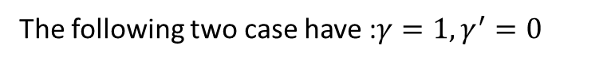
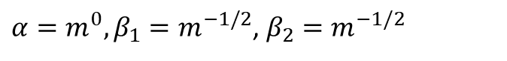
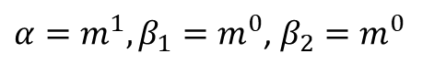
Regime identification through experiments
$$γ^{′}=0$$
The following two case have :$γ=1,γ^{′}=0$
$α=m^{1},β_{1}=m^{0}$, $β_{2}=m^{0}$
$α=m^{0},β_{1}=m^{−1/2}$, $β_{2}=m^{−1/2}$
T Luo#, ZQJ Xu#, Z Ma, Y Zhang*, Phase diagram for two-layer ReLU neural networks at infinite-width limit, JMLR, 2020

Slide 15
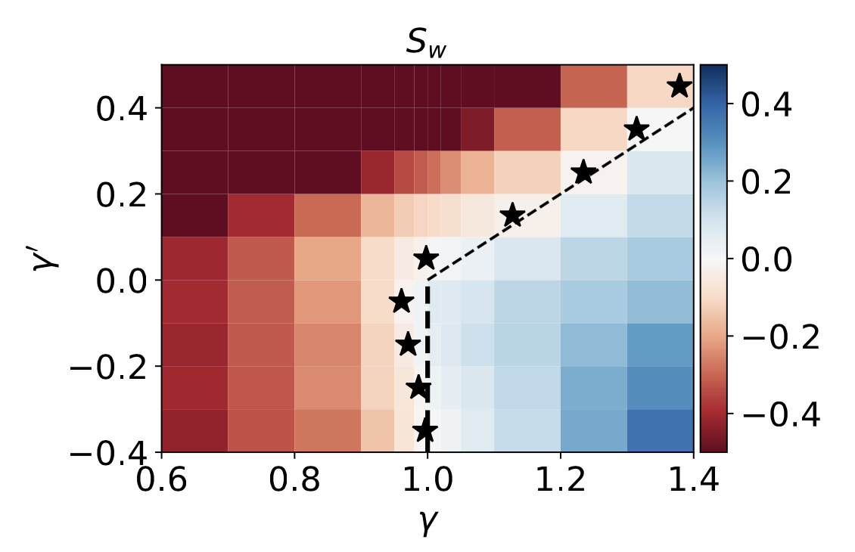
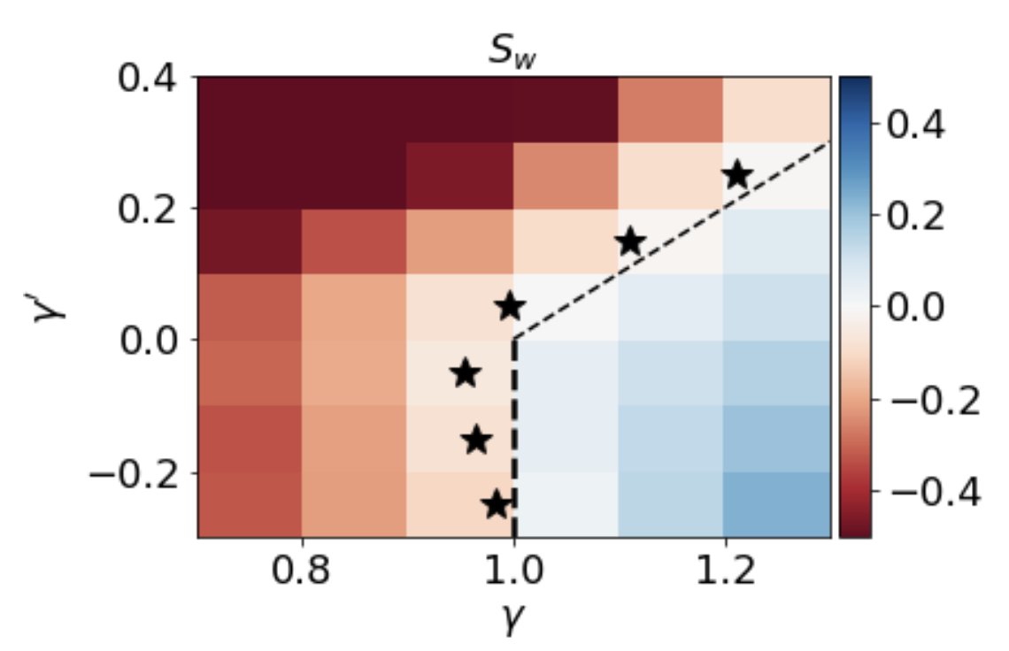
Regime identification through experiments
Synthetic data
MNIST data
T Luo#, ZQJ Xu#, Z Ma, Y Zhang*, Phase diagram for two-layer ReLU neural networks at infinite-width limit, JMLR, 2020

Slide 16
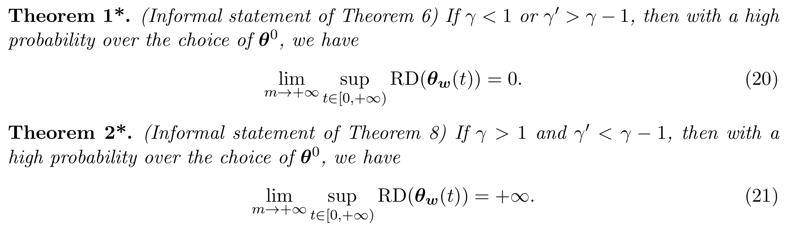
Regime separation -- theorems
Tao Luo#, Zhi-Qin John Xu #, Zheng Ma, Yaoyu Zhang*,
Phase diagram for two-layer ReLU neural networks at infinite-width limit, Journal of Machine Learning Research (2021)

Slide 17
T Luo#, ZQJ Xu#, Z Ma, Y Zhang*, Phase diagram for two-layer ReLU neural networks at infinite-width limit, JMLR, 2020

Slide 18
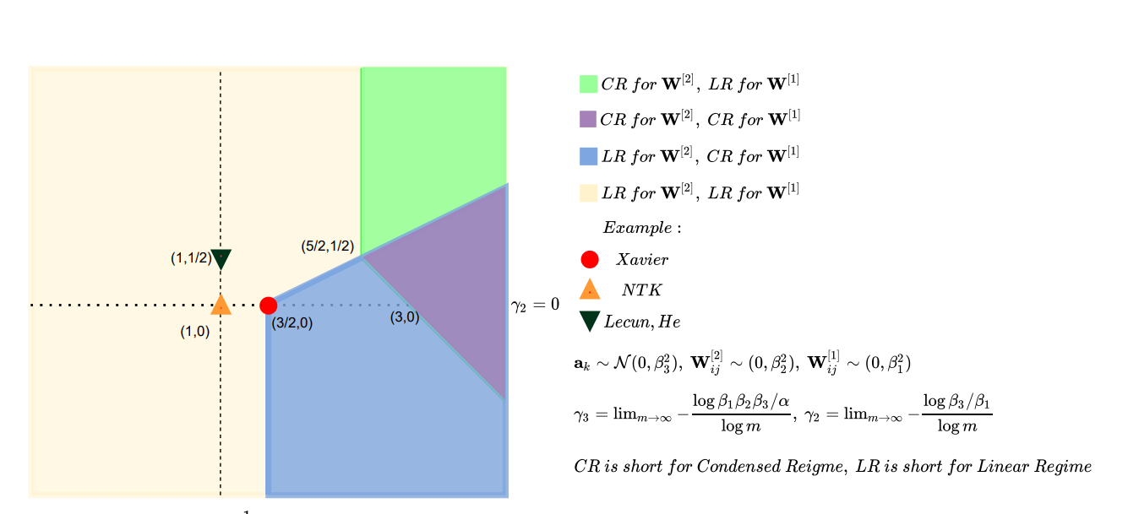
Phase diagram: condense in non-linear regime
Three-layer ReLU network
Luo#, Xu#, Ma, Zhang*, 2007.07497, JMLR; Zhou, Zhou, Jin Luo, Zhang, Xu, NeurIPS 2022

Slide 19
Linear Regime

Slide 20
Linear approximation for wide NN
$h\left(x, θ(t)\right)=h\left(x,θ_{0}\right)+∇_{θ}h(x,θ_{0})\left(θ\left(t\right)−θ_{0}\right)$ for any $t>0$
$$\frac{dθ(t)}{dt}=−∇_{θ}h{\left(X,θ_{0}\right)}^{T}\left(h\left(X,θ\left(t\right)\right)−Y\right)$$
$$L\left(θ\right)={\frac{1}{2}\left\|h\left(X,θ\right)−Y\right\|}_{2}^{2}$$
$$X:{\left[x_{i}\right]}_{i=1}^{M} Y:{\left[y_{i}\right]}_{i=1}^{M}$$
CIFAR 10, CNN
Lee et al., 2019

Slide 21
Critical Regime

Slide 22
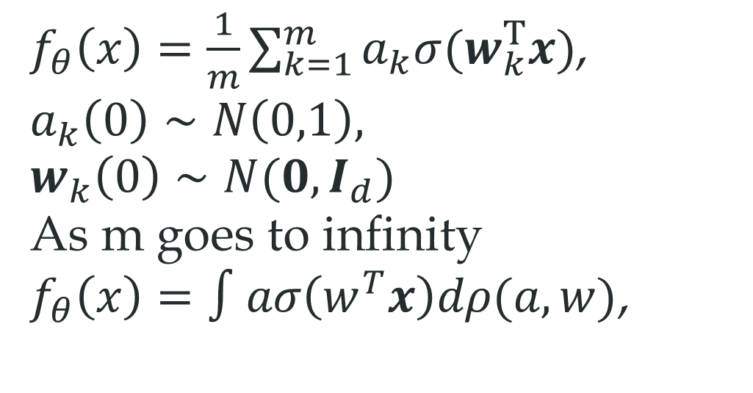
Mean field regime
$f_{θ}\left(x\right)=\frac{1}{m}\sum_{k=1}^{m}{a_{k}σ(w_{k}^{T}x)}$,
$$a_{k}\left(0\right)∼N\left(0,1\right), w_{k}\left(0\right)∼N(0,I_{d})$$
As m goes to infinity
$f_{θ}\left(x\right)=∫aσ\left(w^{T}x\right)dρ(a,w)$,
This is a non-linear regime

Slide 23
Condensed Regime

Slide 24
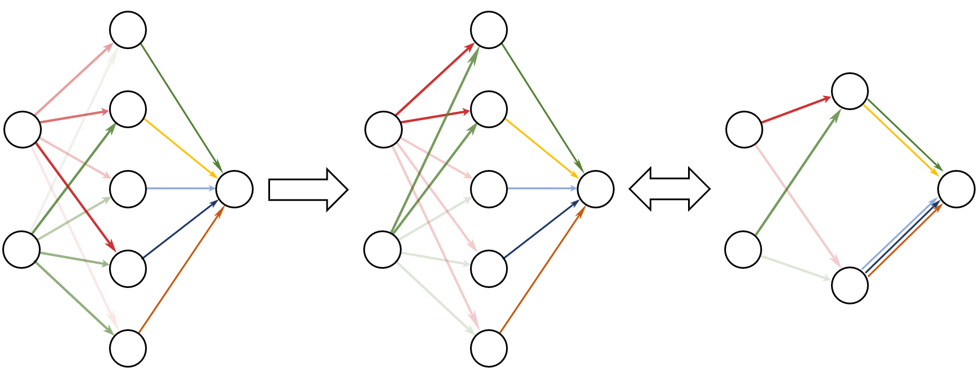
Condensation
Initial: Neurons different
After training: Clustered
Effective small net
Condense
Embedding
Luo#, Xu#, Ma, Zhang*, JMLR, 2021

Slide 25
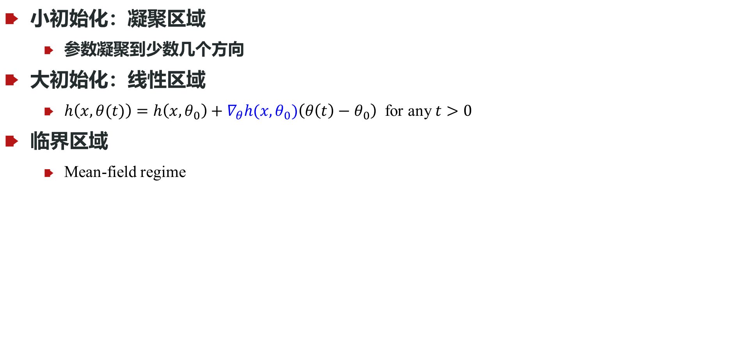
小结
小初始化：凝聚区域
参数凝聚到少数几个方向
大初始化：线性区域
$h\left(x, θ(t)\right)=h\left(x,θ_{0}\right)+∇_{θ}h(x,θ_{0})\left(θ\left(t\right)−θ_{0}\right)$ for any $t>0$
临界区域
Mean-field regime
T Luo#, ZQJ Xu#, Z Ma, Y Zhang*, Phase diagram for two-layer ReLU neural networks at infinite-width limit, JMLR, 2020

